Slide 1
APJII Training Incident Response
15 April 2026
Digit Oktavianto
https://threathunting.id

Slide 2
Agenda
Dwell Time in Cyber Security
Log, Security Events, Alert, Incidents
Introduction to DFIR
Detection Engineering Core Process
Log Sources and Telemetry
Prioritization of Log Sources
Network Security Incidents

Slide 3
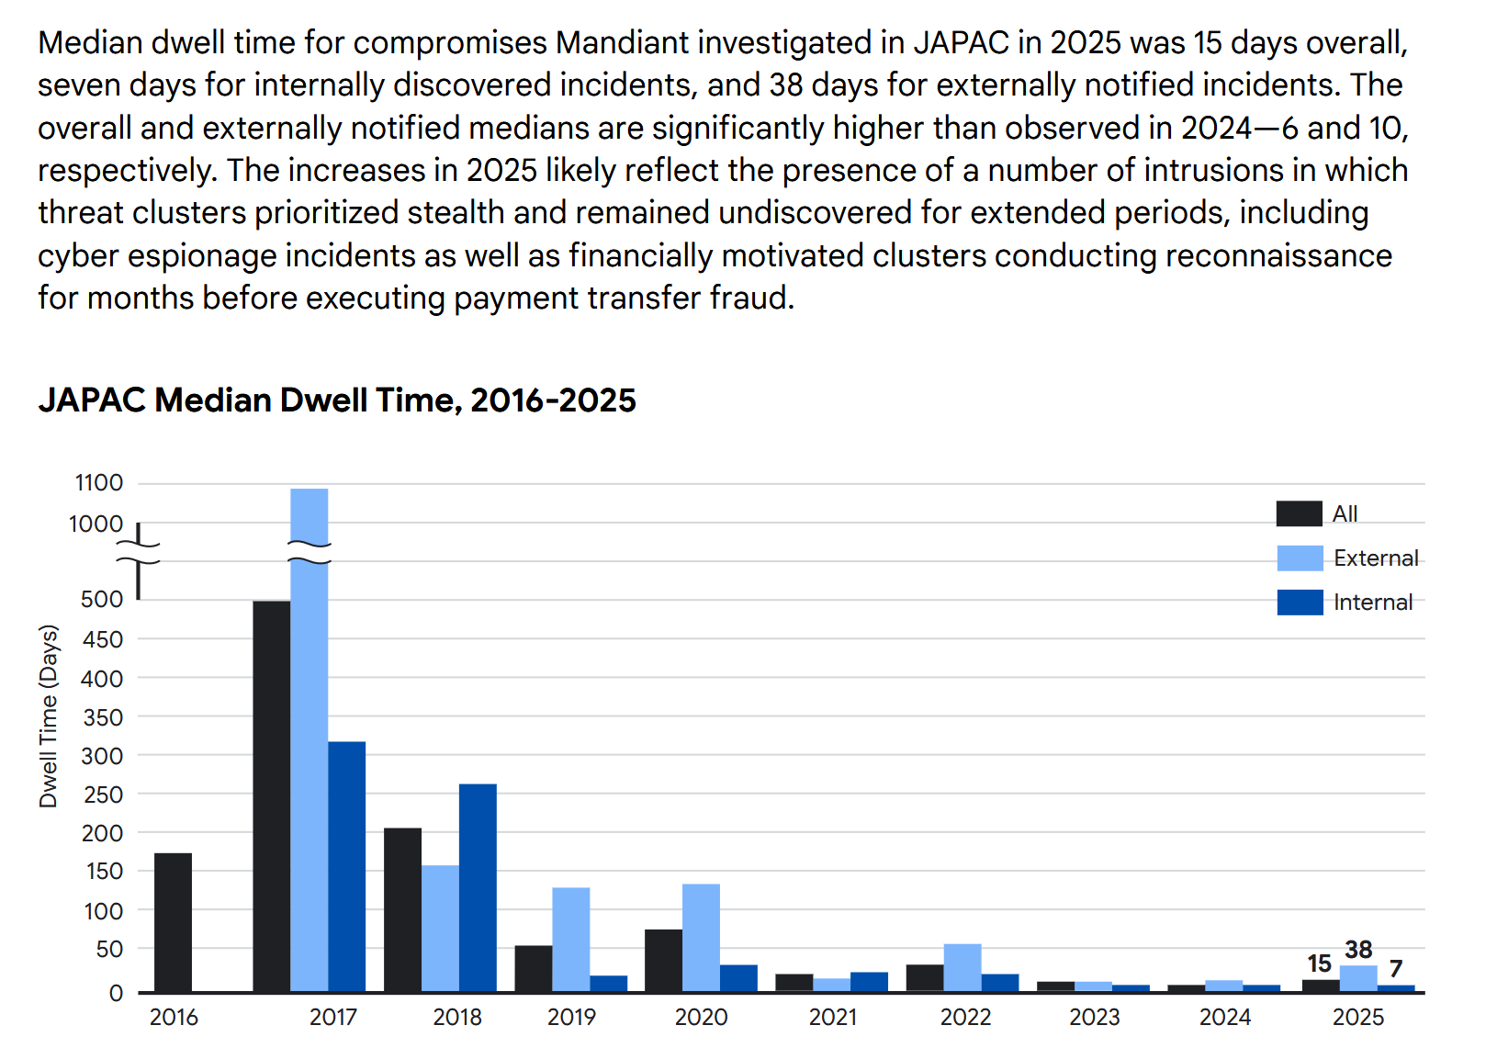
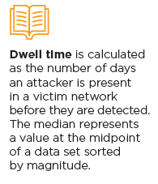
Dwell Time In Cyber Security
Mandiant M-Trend Report 2026

Slide 4
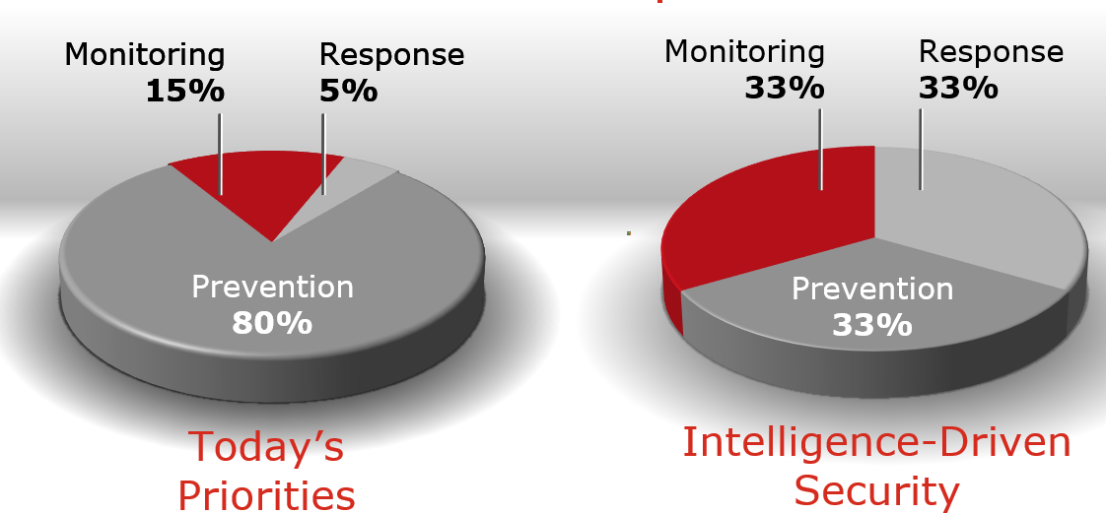
Shifting Priority in Cyber Security

Slide 5
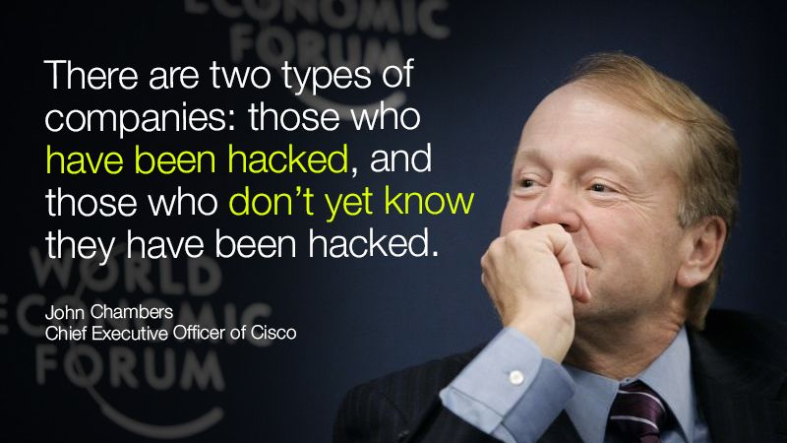

Slide 6
Logs, Security Events, Alert, and Incidents

Slide 7
Logs
Definition: Logs are records of events generated by operating systems, applications, and other devices. They contain information about the activities and operations that have taken place within an IT environment.
Purpose: Logs are used for monitoring system behavior, troubleshooting issues, and conducting forensic analysis.
Example: A log entry might record a user login attempt, a file access, or an error message from an application.

Slide 8
Security Events
Definition: Security events are specific occurrences identified within logs that may have security implications. They are events that are flagged as potentially relevant to security.
Purpose: Security events help in identifying suspicious activities that might indicate a security threat or breach.
Example: Multiple failed login attempts within a short period can be recorded as a security event.

Slide 9
Security Events – Adverse Events
What?
Events with a negative consequence
Examples:
System crashes
Network packet floods
Unauthorized use of system privileges
Unauthorized access to sensitive data
Execution of malicious code that destroys data

Slide 10
Alerts
Definition: Alerts are notifications generated by security systems when certain predefined conditions or thresholds related to security events are met. They serve as warnings to IT and security teams.
Purpose: Alerts prompt immediate attention and action to potential security issues.
Example: An alert might be triggered if a security event, like an unusual login attempt from a foreign IP address, occurs.

Slide 11
Incidents
Definition: Incidents are confirmed security breaches or attacks that require a response. They are escalated from security events that have been validated as actual threats.
Purpose: Managing incidents involves investigation, mitigation, recovery, and lessons learned to prevent future occurrences.
Example: A detected malware infection or a data breach is classified as an incident.

Slide 12
Correlation Between Logs, Security Events, Alerts and Incidents
Logs are the raw data that record all activities within the system. They form the foundational data source for detecting security-related activities.
Security Events are identified from logs when specific patterns or anomalies are recognized that might indicate a security concern.
Alerts are generated based on security events to notify the relevant personnel about potential security issues requiring immediate attention.
Incidents are confirmed security events that have been validated as real threats and need to be addressed through a structured response process.

Slide 13
Introduction to Digital Forensic and Incident Response

Slide 14
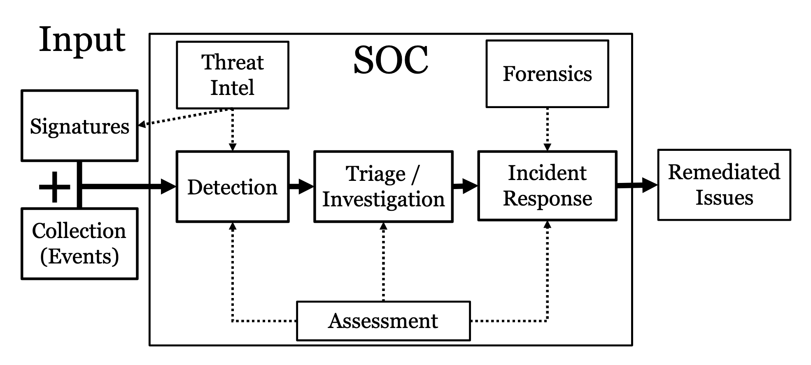
Illustration of SOC Function

Slide 15
Incident Response
Incident response is the process of identifying, containing, eradicating, and recovering from security incidents in an organization.
Objective of IR is to mitigate the immediate impact of an incident and restore normal operations as quickly as possible.
Scope:
Respond to incidents like ransomware, data breaches, or insider threats.
Limit damage and prevent further compromise during an attack.
Develop incident response plans, playbooks, and post-incident lessons learned.
Methodology:
Focused on rapid triage, containment, and remediation.
Includes a proactive approach like monitoring, hunting, and preparation

Slide 16
Digital Forensic
Digital forensics focuses on the preservation, identification, extraction, analysis, and documentation of digital evidence in a structured and legally defensible manner.
Objective of Digital Forensic to determine "what happened" in a system or network after an incident has occurred, often as part of legal investigations.
Scope:
Collect evidence from devices like computers, phones, servers, or cloud environments.
Analyze malware, logs, and artifacts to reconstruct the timeline of events.
Support legal cases by providing forensic reports and expert testimony.
Methodology:
Highly structured with strict adherence to chain-of-custody procedures.
Goal-oriented towards producing evidence admissible in court.

Slide 17
Between DF and IR
While digital forensics and incident response have distinct objectives and methodologies, they are complementary. The term DFIR (Digital Forensics and Incident Response) exists because in practical scenarios, the two functions often overlap significantly:
Incident Response Needs Forensics:
During an incident, forensic techniques are used to analyze logs, malware, or compromised systems.
Evidence collected helps IR teams understand the attack, identify its source, and determine its impact.
Forensics Needs Incident Response:
Forensic Investigators extend the works from analysis of IR Teams to digging deep more details into the incident case.
Forensic investigators often rely on IR teams to secure systems or networks before evidence collection.
A poorly handled response can lead to evidence tampering or loss

Slide 18
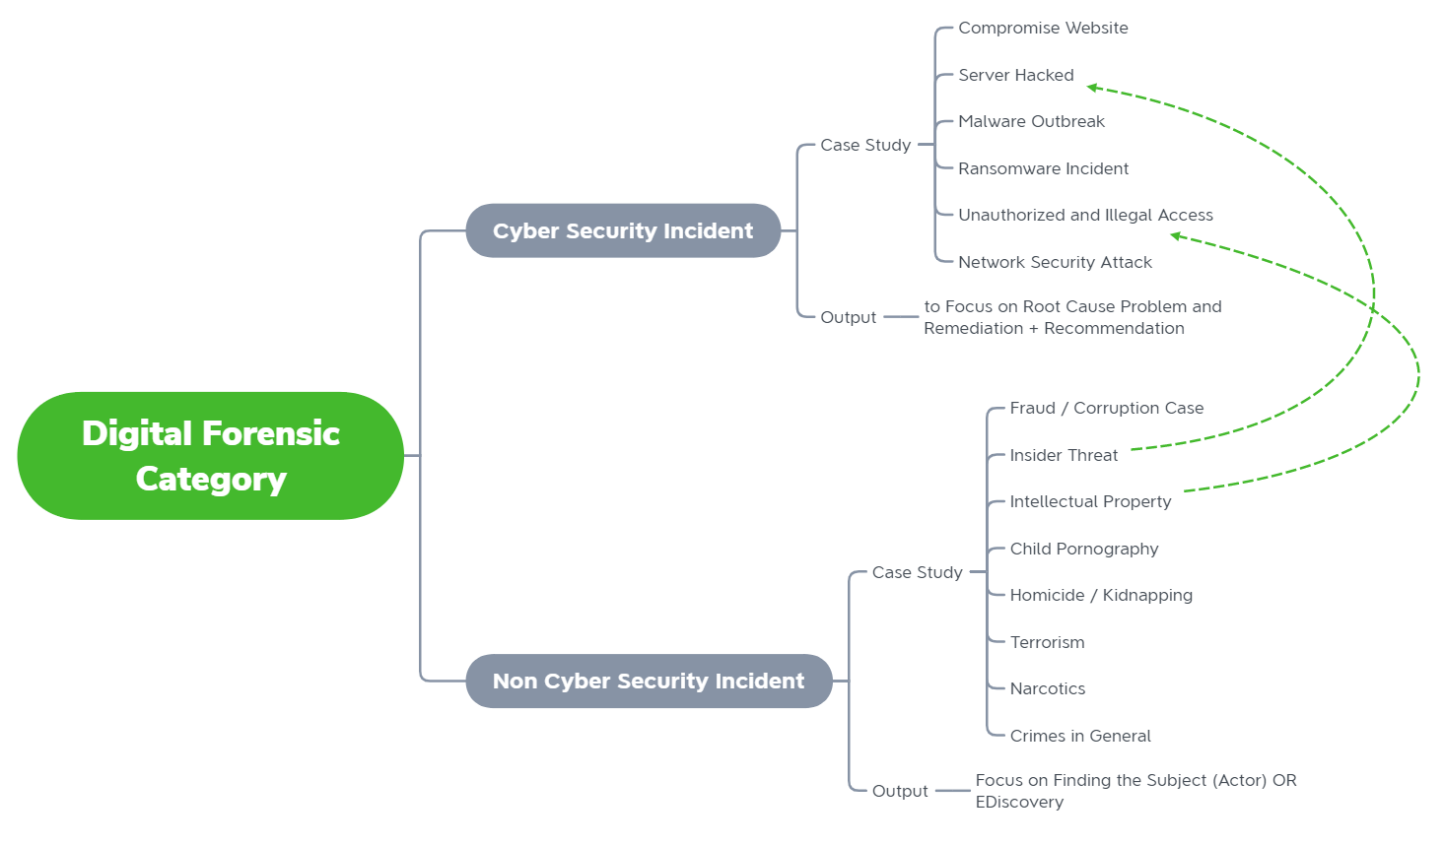
Digital Forensic by Category
Notes:
CyberSecurity Incident dan Non-Cyber Security Incident berbeda dalam outputnya.
Terkadang non-cyber security Incident akan bersinggungan dengan adanya aktivitas cyber security

Slide 19



DFIR Investigation
Observation
1” blue icon
Conclusion
1” grey icon
1” orange icon
Question
DFIR Investigation
1” yellow icon
1” yellow orange icon
Answer
Hypothesis

Slide 20
Investigator Mindset
Create a hypothesis
Understand what evidence you need to prove it
Determine if the evidence is attainable
Review and analyze the evidence
Confirm if your hypothesis is correct, incorrect, or unable to be determined

Slide 21
Analysis Process in Cyber Investigation
Understanding OS, Applications, Network.
Evidence Created
User Generated Activity
System Activity
Analytical Thinking
Problem Solving Skills
Require Analysis
Not only doing the data extraction
5W, 1H

Slide 22
Importance of Incident Response

Slide 23

Why It is Important?
Cyber attacks are here to stay (new normal)
Without any plans and workflow, it would be hard to detect and prevent cyber intrusions
FAANG, Big Tech, Startup, SBE, Government, etc can all be hacked. It’s just a matter of when

Slide 24



Why It is Important?
Incident Response is the process of detecting and analyzing incidents and limiting incident;s effect
Critical systems down
Lost or stolen laptops, cellphones
Suspected insider threat
External threat actors
Ransomware, Web shell, etc.

Slide 25
Need for DFIR
Attacks frequently compromise personal and business data, and it is critical to respond quickly and effectively when security breaches occur.
The concept of computer security incident response has become widely accepted and implemented. One of the benefits of having an incident response capability is that it supports responding to incidents systematically (i.e., following a consistent incident handling methodology) so that the appropriate actions are taken.
Incident response helps personnel to minimize loss or theft of information and disruption of services caused by incidents.
The ability to use information gained during incident handling to better prepare for handling future incidents and to provide stronger protection for systems and data

Slide 26
Goals of an DFIR Plan
Verify that an incident has occurred
Maintain or restore Business Continuity
Reduce the impact of the incident
Determine attack vectors and how the incident occurred
Prevent future attacks/incidents
Improve the organization’s security posture
Keep management informed and follow proper chain of command procedures

Slide 27
DFIR Life Cycle

Slide 28
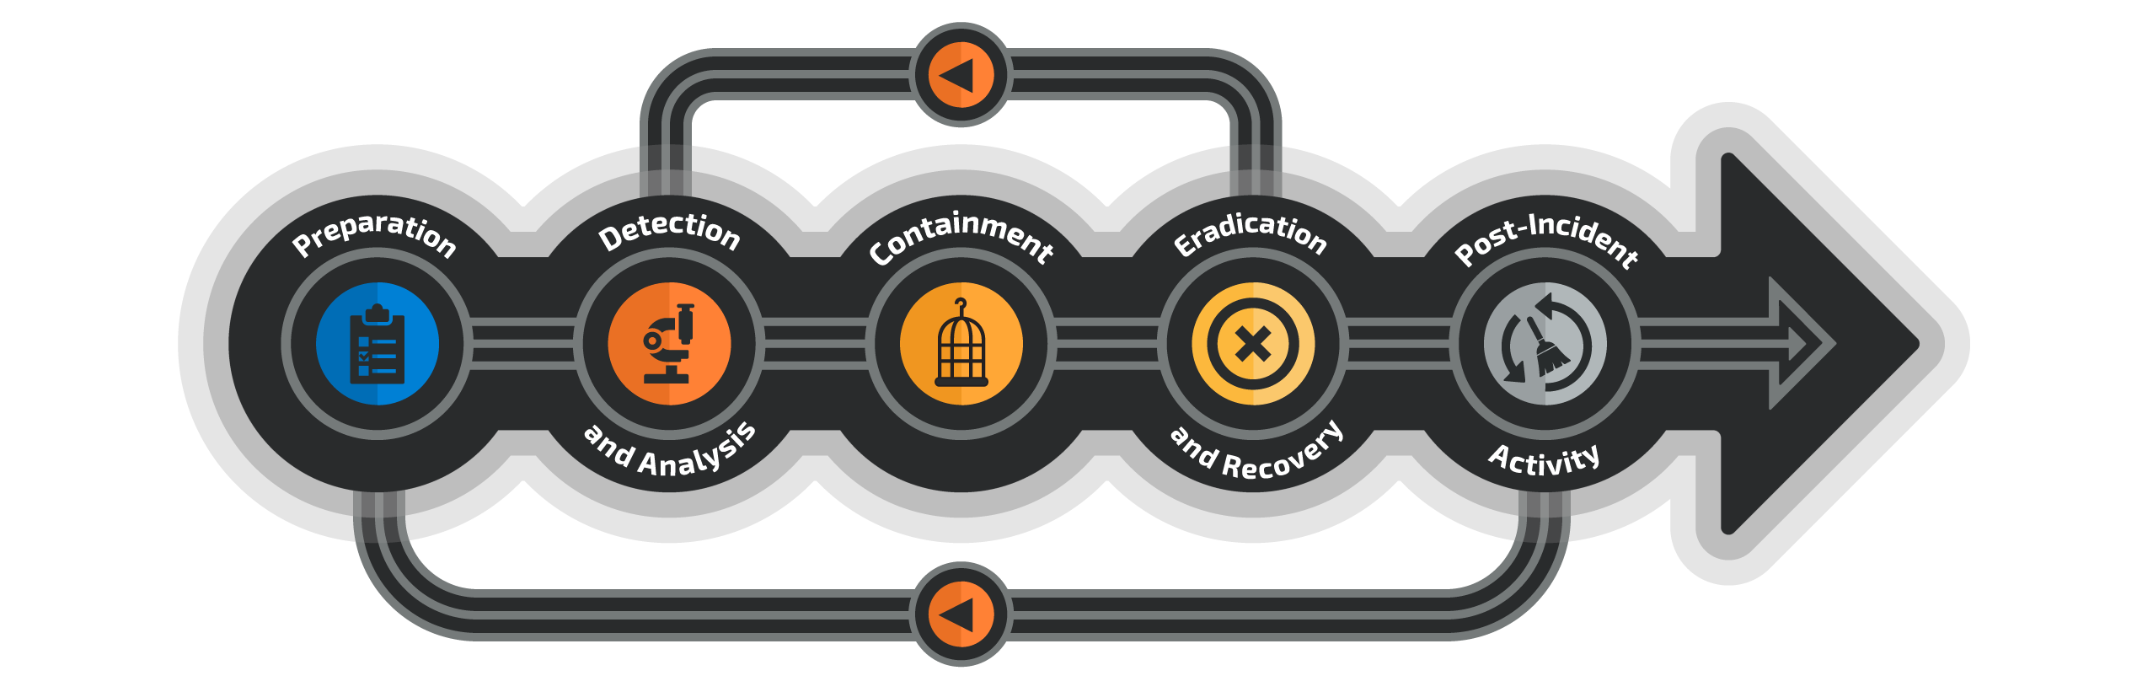
DFIR Life Cycle

Slide 29

Digital Forensic and Incident Response
Using one does not mean you don’t need the other
Incident Response
Assess system to identify leads or suspicious activity
May impact live systems
Triage
Full Disk
Digital Forensics
Thoroughly investigate available data on a system
Should not impact live systems, but could require downtime

Slide 30
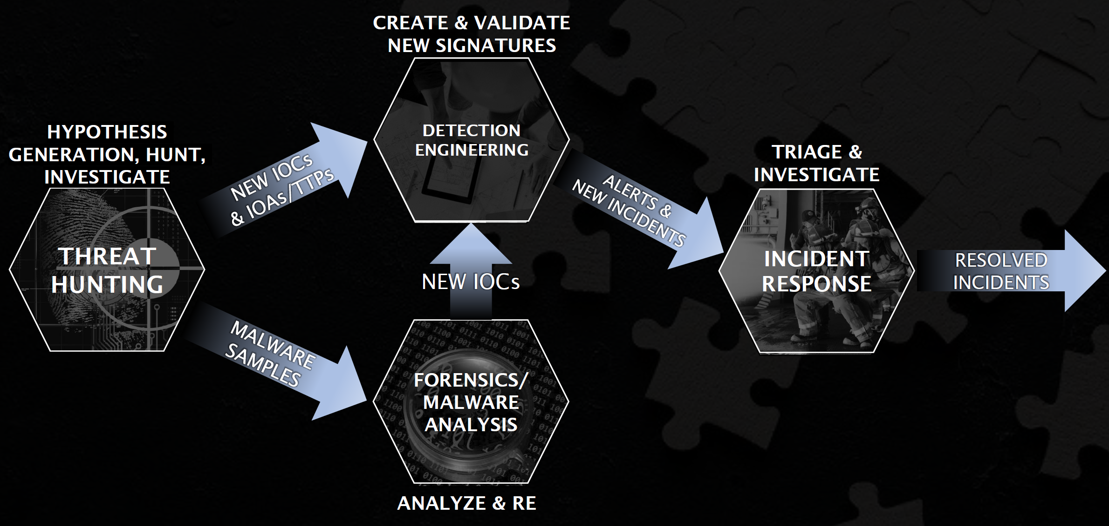
DFIR >< Threat Hunting >< Detection Engineering >< Malware Analysis
SANS Threat
Hunting Summit 2020

Slide 31
Finding Evil
Malicious behavior may not always be identified before IR is engaged.
A baseline of expected activity will make it easier to identify suspicious behaviors
Common indicators:
Use the hypothesis approach to set end points. There will likely be several paths to follow. Note them down, but finish your current hypothesis
Rogue Connections
Unusual Processes
Unusual Services
Rogue Accounts
Unusual Files
Persistence Mechanism

Slide 32
Why ISPs Are a Prime Target

Slide 33
What Makes ISPs Uniquely Valuable to Attackers
ISPs control the backbone of internet — DNS, BGP routing, and bandwidth for millions of downstream customers
Compromise one ISP = simultaneous surveillance or disruption of millions of users' traffic and metadata
ISPs house Lawful Intercept (LI/CALEA) systems — court-authorized wiretap portals — prime nation-state target
BGP routing tables and peering agreements give attackers power to globally redirect internet traffic
ISP networks commonly run legacy equipment (SOHO routers, older IOS versions) with delayed patch cycles
Subscriber databases contain PII for millions: name, address, payment data, usage history
ISPs are supply-chain entry points — compromise one ISP to reach corporate clients, government, hospitals

Slide 34
ISP Threat Landscape — By the Numbers (2024-2025)
200+
Orgs in 80+ countries compromised by Salt Typhoon (China/MSS APT) — FBI August 2025
49%
Of a single US ISP's modems permanently destroyed in 72 hrs — Pumpkin Eclipse, Oct 2023
~2 Yrs
Estimated dwell time of Salt Typhoon inside US telecom networks before detection
$449M
Paid to ransomware groups targeting ISPs & hosting providers in H1 2023 alone
Sources: FBI August 2025, Lumen Black Lotus Labs, Mandiant M-Trends 2024, Cybersecurity Ventures

Slide 35
ISP Attack Surface — What Attackers Target
Network Infrastructure: Core routers (Cisco IOS XE / Juniper / Nokia SR OS), BGP speakers, edge devices
DNS Infrastructure: Authoritative & recursive resolvers — DNS cache poisoning, zone tampering, amplification
Lawful Intercept Systems (CALEA/IRI): Sensitive portals for law enforcement — prime APT persistence target
CPE & SOHO Devices: Customer modems, ONTs, home routers — botnet recruitment & mass destruction
OSS/BSS Systems: Billing, subscriber management, CRM — subscriber data theft, ransomware targets
NOC/SOC Staff Accounts: VPN, jump hosts, monitoring consoles, RADIUS — credential theft vectors
Internet Exchange Peering: BGP peering sessions at IXPs — route manipulation, traffic interception

Slide 36
Threat Actor Categories Targeting ISPs
Nation-State / APT Groups
Salt Typhoon (China/MSS) — US & global ISP espionage, LI system compromise
Volt Typhoon (China) — Pre-position in critical infra for future disruption
Sandworm (Russia) — Destructive attacks on Ukraine telecom (Ukrtelecom 2022)
Lazarus Group (DPRK) — Financial theft via ISP-hosted services
Targets: Core routing, subscriber data, lawful intercept
Criminal & Hacktivist Groups
Ransomware gangs (LockBit, Black Basta) — Encrypt OSS/BSS, demand ransom
DDoS-for-hire: Carpet bombing ISP infrastructure for extortion
Hacktivists: BGP route leaks, website defacement, data dumps
Insider threats: NOC staff with privileged access
Motivations: Financial gain, disruption, ideological

Slide 37
Case Study: Salt Typhoon — Global Telecom & ISP Espionage (2024–2025)
WHAT HAPPENED
Chinese state-sponsored APT (MSS) infiltrated AT&T, Verizon, T-Mobile, Lumen, Windstream + 8 other US telecoms. 200+ orgs across 80 countries compromised. Undetected for up to 2 years.
HOW IT WAS DONE
Initial access via stolen credentials & CVE on Cisco routers. Lateral movement through network. Modified ACLs, created hidden accounts. Deployed Demodex rootkit. Compromised Lawful Intercept systems to wiretap targets.
IMPACT
Millions of call records exfiltrated. Audio of political figures intercepted. LI systems (law enforcement wiretap portals) fully compromised. Dwell time: ~2 years. FBI bounty: $10M. Sanctions imposed Jan 2025.
IR LESSON FOR ISP
ISPs must treat LI systems as crown jewels. Implement continuous network traffic analysis. Validate all BGP neighbors. Audit privileged accounts regularly. Enforce MFA on all NOC/admin access. Monitor Cisco device configurations for unauthorized changes.

Slide 38
Case Study: Operation Pumpkin Eclipse — 600,000 Routers Destroyed (Oct 2023)
WHAT HAPPENED
A single US ISP (believed to be Windstream) had 600,000+ customer modems (ActionTec T3200/T3260, Sagemcom) permanently bricked over a 72-hour window. 49% of their ASN's modems were destroyed.
HOW IT WAS DONE
Attackers used Chalubo RAT (commodity malware). Delivered malicious firmware update that deleted operational code. Devices displayed 'steady red light' and required full hardware replacement. No financial demand made — purely destructive.
IMPACT
Hundreds of thousands of customers lost internet service. Hardware had to be physically replaced at scale. Rural communities (primary customers) were disproportionately impacted. No attribution confirmed.
IR LESSON FOR ISP
ISPs must sign/verify firmware updates cryptographically. Implement CPE management platforms with anomaly detection. Maintain rapid replacement stock for scale-incident scenarios. Monitor TR-069/CWMP traffic for unauthorized commands to CPE fleet.

Slide 39
Case Study: StormBamboo — DNS Poisoning at ISP Level (2023)
WHAT HAPPENED
APT group StormBamboo (linked to Daggerfly/China) compromised an unnamed ISP and poisoned DNS responses at the infrastructure level. Software update requests from customers were redirected to attacker-controlled servers.
HOW IT WAS DONE
Attackers gained access to ISP DNS resolver infrastructure. Modified DNS responses for legitimate software update domains. Pushed MACMA (macOS) and POCOSTICK/MGBot (Windows) malware to unsuspecting users who trusted their software updates.
IMPACT
Enterprise and consumer customers of the ISP received malware through trusted update channels. Difficult to detect since the attack was transparent to end-users. Demonstrates supply-chain danger when ISP infrastructure is compromised.
IR LESSON FOR ISP
ISPs must implement DNSSEC on all authoritative and recursive resolvers. Monitor DNS query anomalies and unexpected zone changes. Implement strict change management on DNS infrastructure. Separate DNS management plane from data plane.

Slide 40
Case Study : Ransomware Targeting ISP Operations
PRIMARY TARGETS: OSS/BSS platforms (billing, provisioning, CRM), NOC workstations, network monitoring dashboards, backup systems — operational paralysis is the goal
INITIAL ACCESS VECTORS: Phishing emails to NOC/IT staff (most common) | Exploited VPN/RDP vulnerabilities | Stolen credentials from dark web | Compromised managed service vendor
ISP-SPECIFIC IMPACT: Provisioning outage (cannot activate new subscribers) | Billing blackout | Loss of visibility into customer circuits | $301K-$400K+ per hour downtime cost
PRE-RANSOMWARE INDICATORS: Disable security tools (AV/EDR) | Delete shadow copies (vssadmin delete shadows) | Modify firewall rules | Create new admin accounts | Lateral movement with PsExec/WMI
NOTABLE ISP RANSOMWARE: Cogent Communications (2022) | Multiple regional ISPs hit by LockBit, Black Basta 2023-2025 | Telecom sector consistently in top 5 ransomware targets
ISP IR STEPS: Isolate infected systems | Identify Patient Zero | Preserve ransom note + encrypted file samples | Restore from offline/immutable backups | Engage Polri Siber/BSSN | DO NOT PAY

Slide 41
ISP IR Maturity — Self-Assessment
REACTIVE (Maturity Level 1-2)
No formal IR policy or playbooks documented
Incident handling is ad-hoc, NOC-led only
No dedicated CSIRT or security response team
No SIEM or ISP-specific monitoring (BGP, DNS)
No BGP anomaly detection or RPKI deployed
No documented escalation path or contact list
Post-incident: verbal discussion only, no PIR
No regulatory notification workflow tested
PROACTIVE (Target: Maturity Level 4-5)
Documented IR playbooks per ISP attack type
Dedicated IR/CSIRT team with clear roles & RACI
24/7 SOC with ISP-tuned Sigma detection rules
BGP monitoring + RPKI/ROA deployed for all prefixes
DNSSEC on all zones + DNS query log analysis active
Quarterly tabletop exercises with all stakeholders
PIR process + regulatory reporting workflow tested
Member of ID-CERT, APNIC CERT, and MANRS

Slide 42
Building ISP IR Capability — 90-Day Roadmap
DAYS 1-30 (Foundation): Document current IR process | Identify and classify critical assets (BGP, DNS, LI systems, OSS/BSS, subscriber databases) | Establish IR team contacts and escalation tree | Register with ID-CERT and APNIC CERT
DAYS 31-60 (Detection): Deploy NetFlow collection and establish traffic baseline | Enable DNS query logging on all recursive resolvers | Configure BGP route monitoring (BGPmon alerts + RIPE RIS subscription) | Deploy RPKI ROA for ALL ISP-owned prefixes
DAYS 61-90 (Response Capability): Develop 3 priority ISP playbooks (BGP hijack, DDoS response, Subscriber data breach) | Conduct first tabletop exercise with NOC + Security + Legal + Compliance | Establish and test regulatory notification workflow with BSSN/Kominfo
CONTINUOUS (Ongoing): Monthly review of SIEM detection rules against latest ATT&CK TTPs | Quarterly tabletop drills with ISP-specific scenarios | Annual red team / purple team exercise targeting ISP attack surfaces
ZERO TRUST QUICK WINS: (1) MFA on all VPN and management console access | (2) Separate admin VLAN from production network | (3) Disable default credentials on ALL network devices | (4) SSH key authentication (disable password SSH)
THREAT INTELLIGENCE: Subscribe to APNIC, Team Cymru, Shadowserver threat intelligence feeds | Participate in ID-SIRTII IOC sharing | Monitor BSSN CSIRT advisories | Join MANRS for routing security community

Slide 43
DFIR Readiness

Slide 44
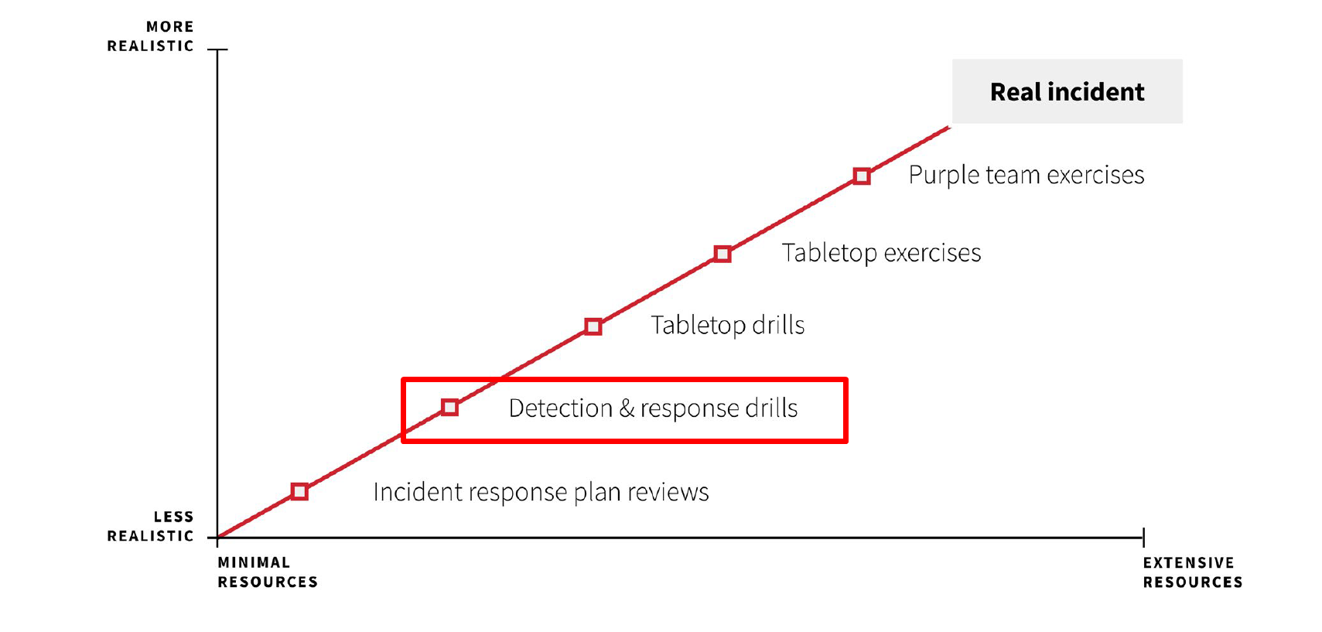
DFIR Readiness Program Example
Red Canary Incident Response and Readiness Guide

Slide 45
What is missing?
What logs each device, application etc, will generate?
What type of logs are required to investigate a security incident?
What type of logs are required to be captured for the type of attack?
What type of logs are tobe fed into SIEM for threat alert/modeling?
What format they should be collected?
How to preserve the logs(data)?
How long they should be retained?
What is the Legal & Regulatory requirements?

Slide 46
Let’s Stop for a While
Take a Look at Cyber Incident Response Readiness Checklist by ACSC (Australia Cyber Security Center) :
https://www.cyber.gov.au/sites/default/files/2023-03/ACSC%20Cyber%20Incident%20Readiness%20Checklist_A4.pdf

Slide 47
What is Digital Forensic Readiness?
Definition
The achievement of an appropriate level of capability by an organization in order for it to be able to collect, preserve, protect and analyze digital evidence so that this evidence can be effectively used in any legal matters, in disciplinary matters, in an employment tribunal or court of law.
Is it reactive?
Definition
the ability of an organization to maximize its potential to use digital evidence while minimizing the cost of an investigation.
Proactive And Predictive
Forensic Readiness
Security Incident
Data
Collection
Data
Analysis
Interpretation
Incident Containment

Slide 48
Are you ready - Digital Forensic Readiness checklist
Identify the business scenarios and various threats both external and internals.
Identify potential sources and types of data – devices, applications, data bases
Map the sources of data with threat.
Identify the collection and retention requirement – Legal, Regulatory compliance
Test and improve the forensic preservation, collection and chain of custody capability
Awareness of SOC and IR team forensic capability
Document evidence-based cases, describing the incident and its impact.
Ensure legal review to facilitate appropriate action in response to an incident
Test the sufficiency at regular intervals.

Slide 49
Enterprise Log Data Flow

Slide 50
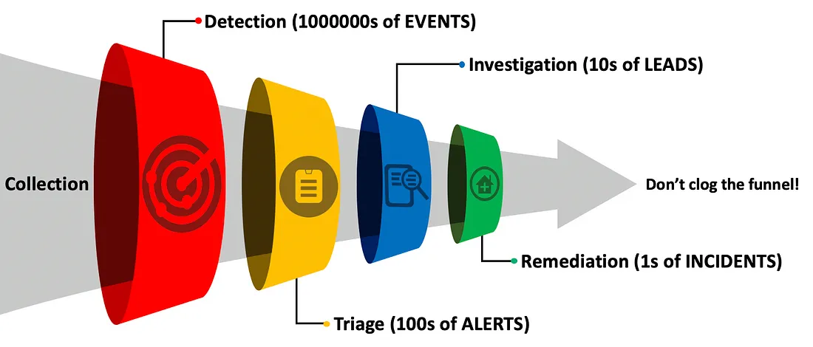
The Funnel of Fidelity
https://posts.specterops.io/introducing-the-funnel-of-fidelity-b1bb59b04036

Slide 51
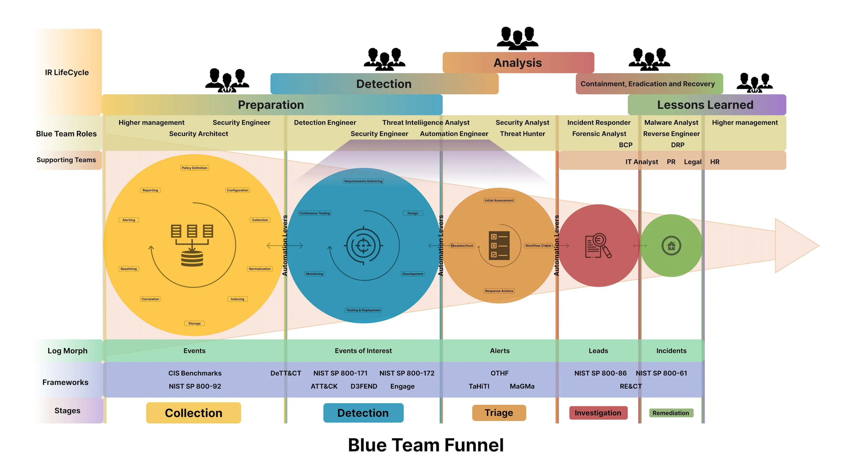
Blue Team Funnel
https://d4rkciph3r.medium.com/establishing-a-detection-engineering-program-from-the-ground-up-b170811166c

Slide 52
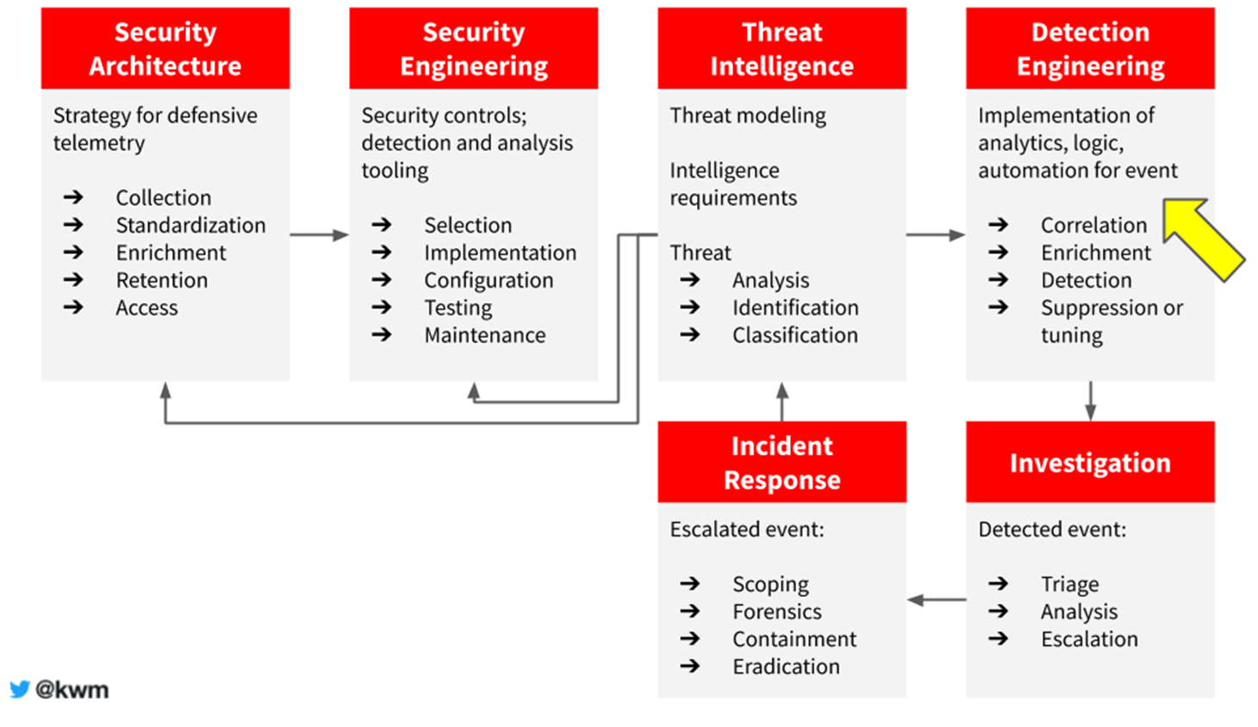
Modern Threat Analysis, Detection, and Response
https://x.com/kwm/status/1260599938590797824

Slide 53
Losing Battle
Adversaries
Constantly Improving Tools
Constantly expanding Technique
Ever Growing Attack Surface
Highly Motivated
Highly Funded? (Nation State Actor)
Cyber Security Team
Resource Shortage
Limited visibility
Limited Budget
Alert Fatigue, Too many to handle
Not Motivated?

Slide 54
Detection Engineering Core Process

Slide 55
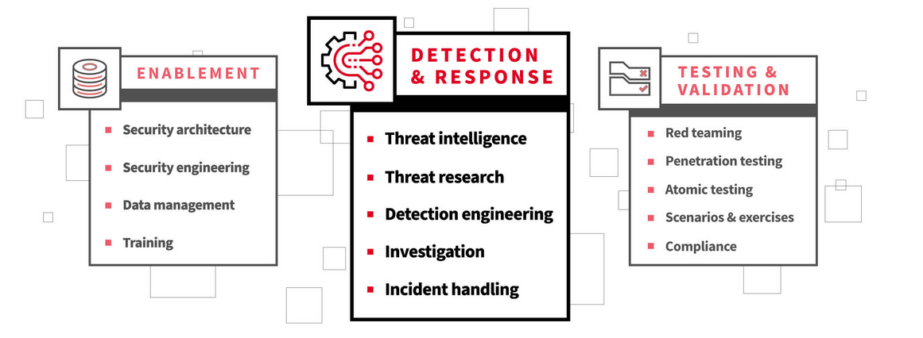
Development Step for Building Modern SOC
https://redcanary.com/blog/modern-security-operations-center/

Slide 56
Detection Engineering
Depends on your data and tech stack
SIEM, SOAR, EDR, NIDS, HIDS, etc.
Can be simple or complex
IOC
TTPs
Correlation
Dashboards
Thresholds
ML
Understanding the Detection = Knowing how to detect the threat, using the data and threat

Slide 57
Detection Engineering in Cyber Security Org
Research
Threat Hunting
DFIR
Threat Intel
Red Team
Vulnerability Mgmt.
Developers
Operation
SOC
MDR
MSSP
Detection Engineering
Engineering
Data Engineering
Platform Engineering
Data Scientist
ML
Logging
System Admin Network Admin
App Developers

Slide 58
Requirements for Detection Engineering Program
Subject Matter Experts
Environmental awareness
Logs, Data, Platform and Organizational
Risk and Threat awareness
Internal, External, etc.
Logs and Telemetry
From all kind of sources
Better if already Data Engineered
Better if Centralized (such as using SIEM)
Platform
A place for Detection Engineer to play and work with telemetry alerts
SIEM is a good start
Organization Maturity
The organization should have other security arms ready
Escalation and Investigation by SOC
Incident Response by DFIR
Platform Engineering

Slide 59
threat
data
detection

Slide 60
Threats (TTP)
Some great sources to learn about Threats
Past cyber security incidents or breaches
Threat Intelligence Reports
Security Advisories
Known frameworks such as Pyramid of Pain, MITRE ATT&CK and Lockheed Martin Cyber Kill Chain
Other Sources : Conference, Blog Post
Understanding the threat = Knowing what to detect the threat

Slide 61
Data (Logs or Telemetry)
Divided into 3 distinct domains
Network
Endpoint(Host, Server, Desktop, Mobile Device, IoT, ICS…)
Cloud (Including Cloud Apps)
Knowing the baseline of our own environment
Understanding the data = Knowing where to detect the threat

Slide 62
Log Sources and Telemetry

Slide 63
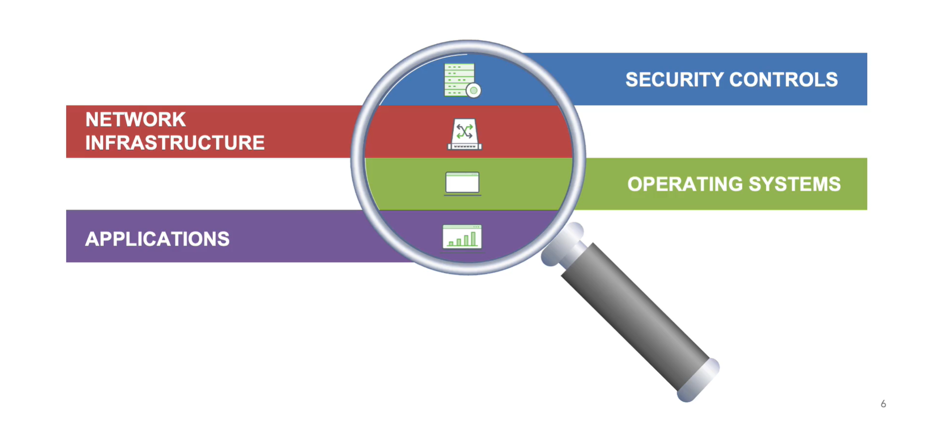
Log Sources and Telemetry

Slide 64
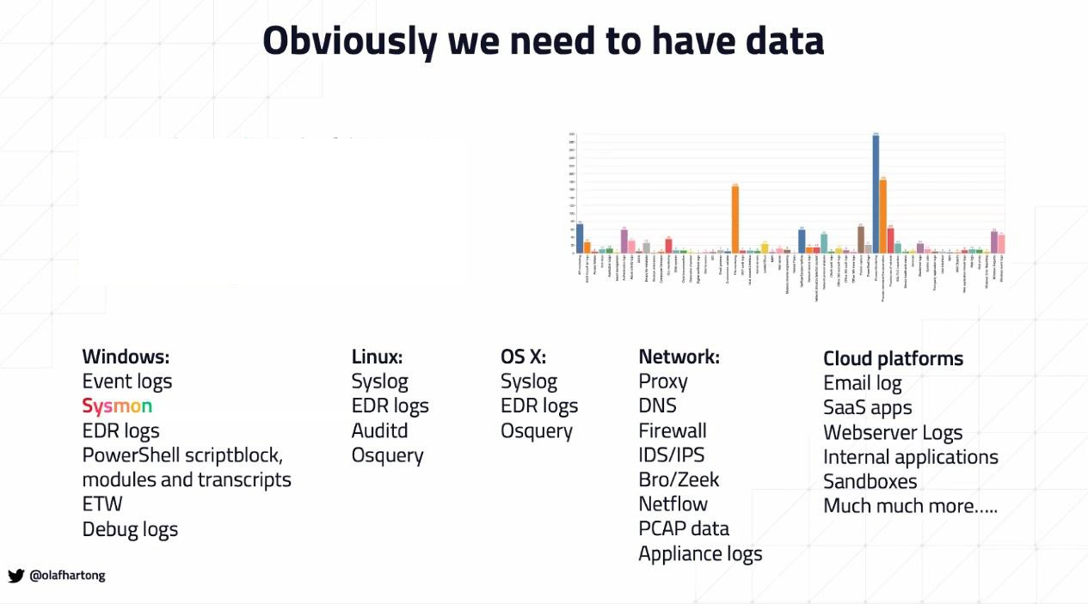
Data… Data… Data…

Slide 65
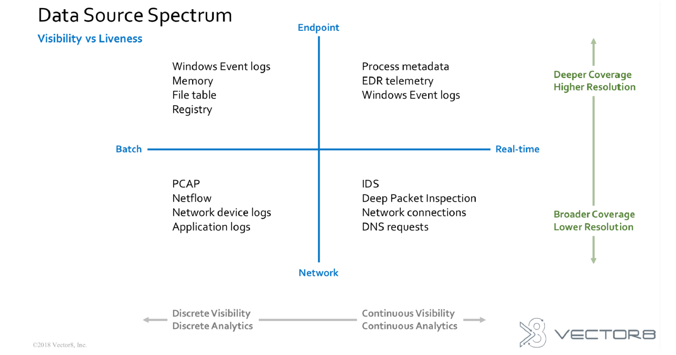
Data Source Spectrum
Source : Fidelis Cyber Security and Vector8 About Data Source Spectrum

Slide 66
Example of Data Sources from Endpoint
Type of Data | Description | Tools
Operating System logs | Useful Data sources. By Default capabilities for each OS. | Built in Function from OS
Process Activity | Process start, DLL libraries loading, Process install driver, Process perform code injection, Process open port for incoming network connections, connections, Process initiate network connection, Process create/change file, Process create/change registry key/value | Sysmon (Windows) Auditd (Linux) Osquery Endpoint Detection Response Operating System Logs
Volatile Artifacts | Temporary artifact collected from endpoint data sources for the purposes of hunting that might not touch the disk on the host Data Collection : Memory, Network Conn, Process Conn, | Winpmem, Comae, (for Collecton) EDR Volatility Google Rapid Response (GRR) Velociraptor
Non-Volatile Artifacts | Artifacts that resides on the endpoint / host disk. Data Collection : Prefetch, Amcache, Shimcache, MFT, Registry, bash_history, Task Scheduler | Brimorlabs KAPE Kansa FastIR Collector

Slide 67
Endpoint Telemetry
HDS/EDR/AV
Such as Sysmon, OSQuery, MDE, Crowdstrike
Process Activity
Module, Library, DLLs, Pipe Activity
File Activity
Registry Activity
Network Activity
Detection/Prevention Activity
Host System
Such as Windows, Linux, MacOS, Android, iOS
Execution
Apps and System Activity (PowerShell, Scheduled Task, etc.)
Web Browser Data
Authentication/Permission/IAM
Network (Filtering, etc.)
Server/App
Such as AD/ADFS, Email Server, Web Server, App Server
Auth/Permission/IAM
Apps Activity
Login, User Changes, Orders, etc.

Slide 68
Example of Data Sources from Network
Type of Event | Description | Tools
Netflow | Network traffic flow metadata. NetFlow data is analyzed to create a picture of network traffic flow and volume. used as a network traffic analyzer to determine its point of origin, destination, volume and paths on the network | Silk Nfsen & Nfdump
Packet Capture | Packet Capture is a networking term for intercepting a data packet that is crossing a specific point in a data network. Once a packet is captured in real-time, it is stored for a period of time so that it can be analyzed, and then either be downloaded, archived or discarded. | Moloch, Tcpdump, Wireshark, tshark
Network IDS | A network-based intrusion detection system (NIDS) detects malicious traffic on a network. NIDS usually require promiscuous network access in order to analyze all traffic | Snort, Suricata Bro Commercial NIDS Product
Proxy Log | Proxy server logs contain the requests made by users and applications on your network. This does not only include the most obvious part : web site request by users but also application or service requests made to the internet (for example application updates). | Squid Commercial Proxy Product
DNS Log | One of the constantly re-occurring techniques is DNS-based activities like exfiltration via DNS (Domain Name System) or C2 (Command and Control) communication via DNS. Still, a lot of companies are lacking in DNS logging, missing DNS-based detection rules, or not aware of their own blindspots. Data collected : DNS Server, DNS Collected from Network, Host Based (Sysmon 10), | Passive DNS Log DNS Server

Slide 69
Log Sources – Security Control
Successful and failed connection attempts
Connection states
Suspicious requests
Detected/prevented attacks
Malware scan activites
Missing software updates
Suspicious activities
Exploitation attempts
Authorization events
Alarm events
Network - based Security Controls
Intrusion Prevention Systems (IPS)
Next Generation Firewalls (NGFW)
Web Application Firewalls (WAF)
Network Access Control (NAC) solutions
Web and Email Security Gateways
Host - based Security Controls
Endpoint Detection and Response (EDR)
Anti - malware Software
Physical Security Controls
Camera Systems
Biometric/card access readers
Alarm systems

Slide 70
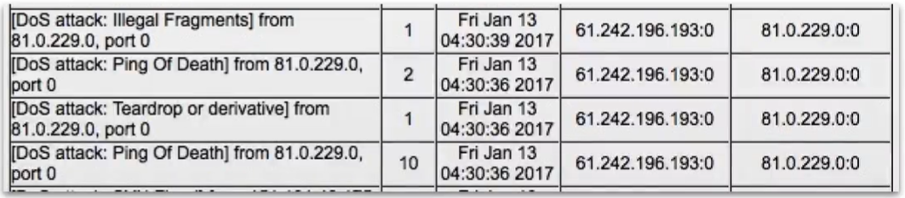
Log Sources - Network Infrastructure
Network Infrastructure
Routers
Switches
Wireless Access Points
DNS server
DHCP server

Slide 71
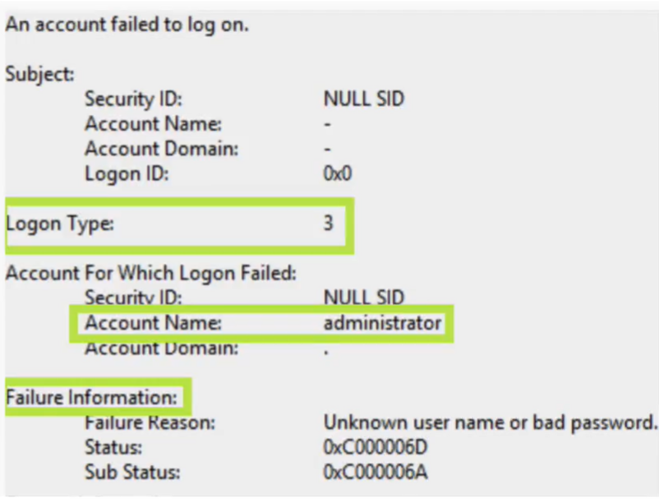
Log Sources – Host Operating Systems
System Events
Servise starts and stops
System startup and shutdown
Audit Records
Authentication attempts
Security policy changes
Account changes
Permission and privilege changes
Use of privileges
File accesses

Slide 72
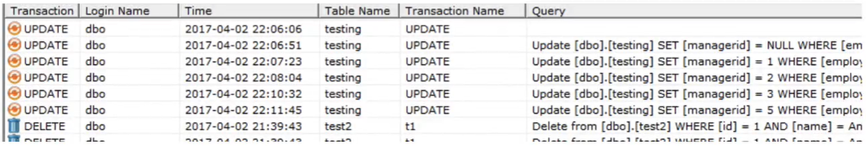
Log Sources - Applications
Account changes
User authentication attempts
Startup and shutdown
Use of privileges
Configuration changes
Application failures
Client requests and server responses
Email servers and clients
Database servers and clients
File servers and clients
Web servers and browsers
COTS applications :
Supply Chain Management (SCM)
Customer Relationship Management (CRM)
Enterprise Resource Planning (ERP)
Financial Management
Custom - developed applications

Slide 73
Prioritization of Log Sources

Slide 74
Deciding Log Sources and Details
What log sources?
What type of event types from the identified sources?
What event attributes of the identified event types?
Security Controls
Network & Physical Infrastructure
Operating Systems
Applications
Successful and failed connection attempts
Authentication attempts
Connection states
Suspicious behavior
Account changes
User authentication attempts
Startup and shutdown
Use of privileges
Configuration changes
Event date and time (timestamps)
Event status
Service/command/application name
User or system account
Protocol
Source IP, destination IP
Source port, destination port
URL
Event type

Slide 75
Good Log Data - Quality and Performances Factors
Quality & Performances Factors : Missing Logs, Irrevent Logs, Time Gap.
Do we collect right log sources?
Do we collect the right logs with the right level of detail?
Do we collect logs with no delay after events?
Is it comprehensive enough not to miss any critical event behind?
And, is it relevant enough to not to overpopulate, create complexity and also not to steal away from event per second license capacity.
Do the logs include the required content?
Delivered and collected with no delay after the after an event takes place.

Slide 76
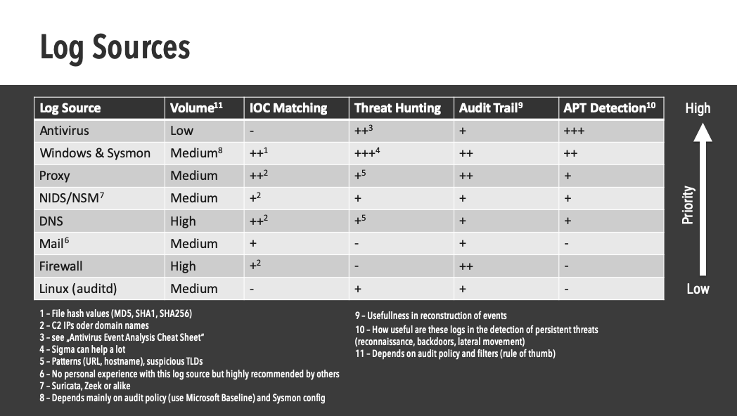
Log Sources Prioritization Example by Florian Roth
https://x.com/cyb3rops/status/1221580082667499522

Slide 77


Slide 78
Network Security Incident

Slide 79
Handling Incidents with Network Security
DoS & DDoS Incidents and Preparing How to Handle It
Incident of Unauthorized Access & Inappropriate Usage
Incident with Many Components
Monitoring, Auditing, and Protecting Network Tools

Slide 80
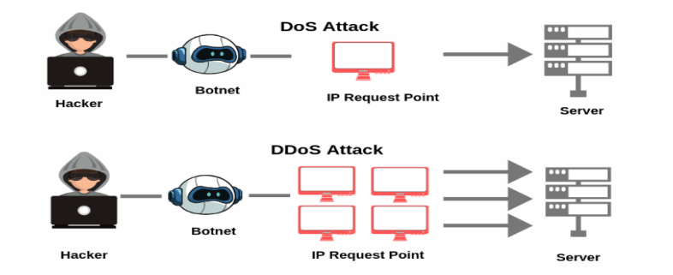
DoS and DDoS Incidents
A denial-of-service (DoS) attack occurs when legitimate users are unable to access information systems, devices, or other network resources due to the actions of a malicious cyber threat actor. Services affected may include email, websites, online accounts (e.g., banking), or other services that rely on the affected computer or network. A denial-of-service condition is accomplished by flooding the targeted host or network with traffic until the target cannot respond or simply crashes, preventing access for legitimate users. DoS attacks can cost an organization both time and money while their resources and services are inaccessible.
A distributed denial-of-service (DDoS) attack occurs when multiple machines are operating together to attack one target. DDoS attackers often leverage the use of a botnet—a group of hijacked internet-connected devices to carry out large scale attacks.

Slide 81
What is Denial of Service?
From security point of view?
Decreased availability
From operations point of view?
An outage
From business point of view?
Financial losses

Slide 82
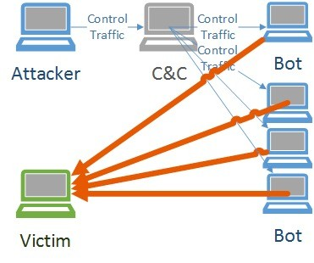
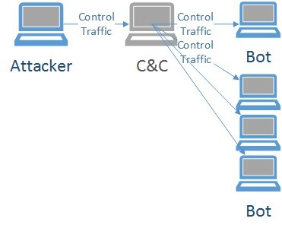
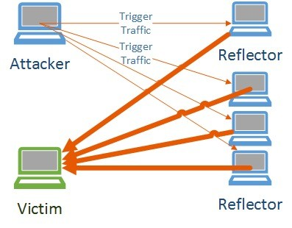
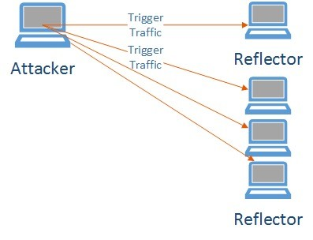
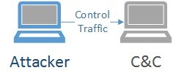
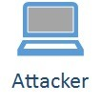
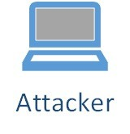
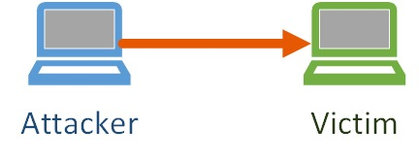
DoS vs. DDoS
What is the difference?
One system is sending the traffic vs many systems
Consider reflected attacks
How does that change the attacks volume?
More systems – more capacity

Slide 83
DoS and DDoS Incidents
Parameter | DOS | DDOS
Full Form | Denial Of Service | Distributed Denial Of Service
Source of Attack | DoS attack typically uses one computer and one internet connection to flood a target system or resource. | DDoS attack uses multiple computers and Internet connections to flood the targeted resource.
Protection | System can be stopped/protected easily | Difficult to protect system against DDOS attack
Threat Level | Low threat Level | Medium to high threat level, as these can be used to do some serious damage to networks and end systems
Malware Involvement | No malware involved | A botnet is usually made up of thousands of infected pc’s
Cost and Management | Easier to operate and manage | Not easy to manage and operate

Slide 84
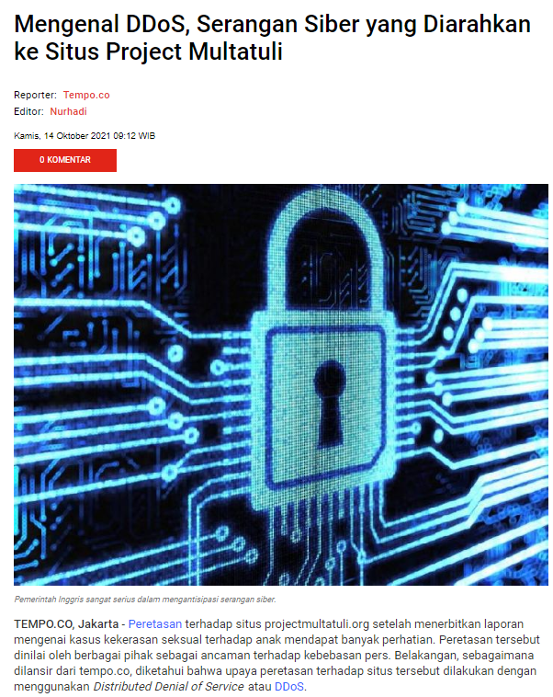
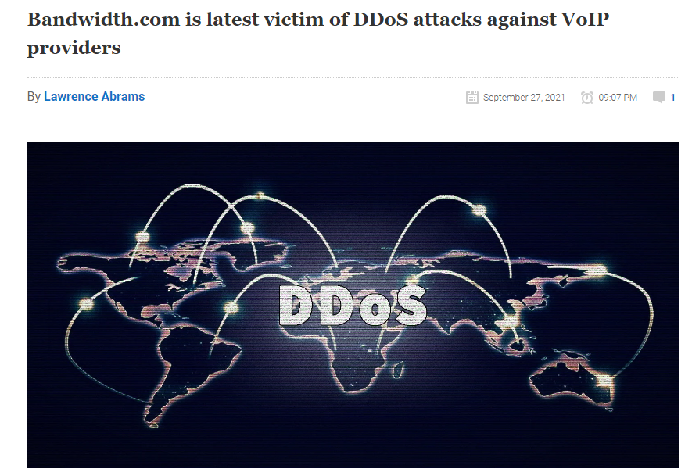
DoS and DDoS Incidents

Slide 85
DoS and DDoS Incidents
Volumetric Attack
Application Layer Attack
The attack consumes the bandwidth of the target network or service
The attack consumes the application resources or service, thereby making it unavailable to legitimate users
Protocol Attack
Permanent Dos Attack
PDoS attack is a denial of service via hardware sabotage. One method of conducting a PDoS attack is commonly referred to as phlashing
The attack consumes othe types of resources like connection state tables present in the network infrastructure components such as load-balancers, firewall, and application servers

Slide 86
Indications of a DoS/DDoS Attack
Network Services | User Reports regarding system unavailability Undefined connection losses Alert from IPS/NIDS Increasing and abnormal bandwith network traffic
Host | User Reports regarding system unavailability Undefined connection losses Alert from HIDS/HIPS Increasing and abnormal bandwith network traffic
Operating Systems | User Reports regarding inaccessibility of a system and/ or an installed application Alert from IDS/IPS Firewall Alerts Operating system-generated logs
System Application | User reports of application unavailability Alert from IDS/IPS Unprecedented application log entries Data packets with abnormal source addresses

Slide 87
Detecting DoS/DDoS Attack
Poll-Based Monitoring and Detection : examine the current reporting capabilities of the hardware and software in your infrastructure
Flow-Based Network Parameter Detections : a flow-based network detection is push-based. the device information is collected on the device itself and pushed to the collector.
Network Mirrors and Deep Packet Inspection : In order to detect the specifics of the attack, we need to actually look at the contents of the packets instead of relying on just the header. This is typically done by placing a network mirror that identify a source port on a network device, makes a copy of the transmitted packet, and transmits out of the mirror port.

Slide 88
Preparing For a DoS/DDoS attack and How to Handle It
02
03
01
04
Identification
Containment
Preparation
Remediation
Analyze attack, Involve internal & external actors, Check the background such as competitor, hacktivist, former employees
Block & absorb the attack, shutdown services, load balancing, throttling
ISP Support, Inventory (Whitelist IP & Documenting IT Infra), Network Infrastructure, Internal Contacts
Rate limiting, Remediation by ISP, IP Reputation Filtering, Egress & Ingress filtering
06
05
Recovery
Post-Incident
Re-start stopped services, Ensure the infrastructure performance is back to your baseline performance
Document the incident and adjust plans for defences

Slide 89

Incident of Unauthorized Access
Unauthorized access Incident are those where an attacker or an intruder gains unauthorized access to the system or network resources by various malicious means.
Intruders involved in unauthorized access include casual hackers, professional hackers, and organizational employees.
Methods of Unauthorized Access :
Exploiting Vulnerabilities
Stealing Access of Data
Social Engineering
Insider Threats

Slide 90
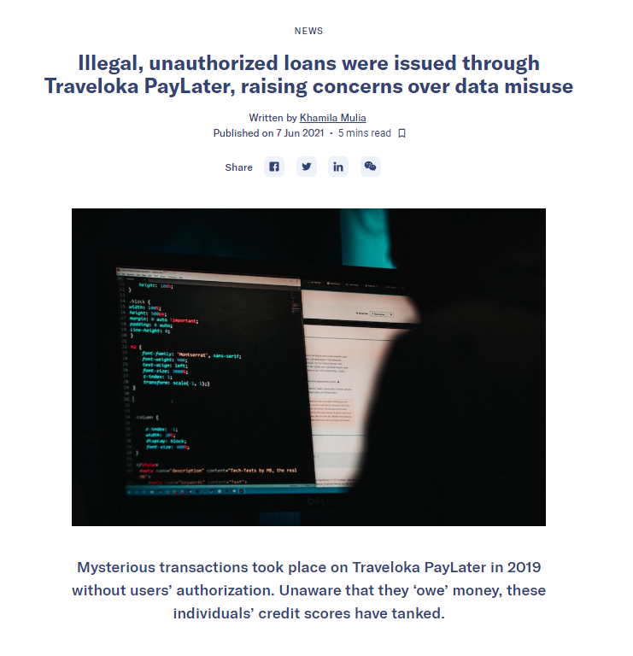
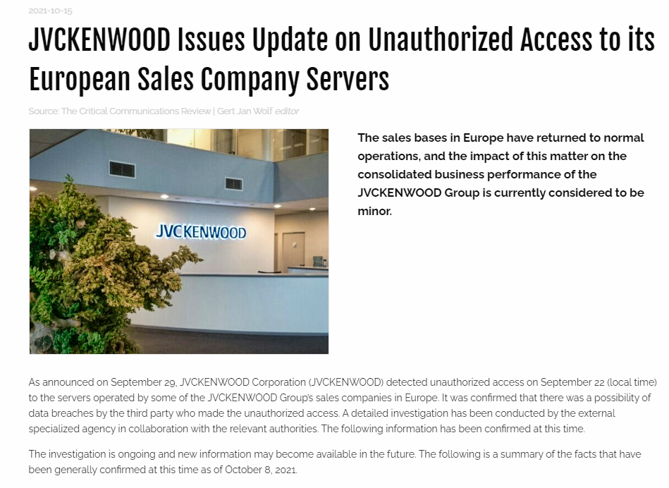
Incident of Unauthorized Access

Slide 91
Indication of Unauthorized Access Incidents
Physical Instrusion | User Reports regarding network or system unavailability System status changes Misplaced Hardware Parts Unauthorized hardware found
Changes in System Configuration | Modifications or addition of services Unpredicted open ports Network Interface card set to promiscuous mode Suspicious tools or exploits Unauthorized system shuts down or restarts
Changes in Network | Strange network traffic User reports of system unavailability Alerts of network and host intrusion detection IDS, IPS, and firewall alert for data access through FTP, HTTP, and other protocols
Changes in Administrator Settings | Changes in log and audit policies Creation of new admin account or user account Change in critical files such as OS files, system library
Unauthorized Data Access | IDS/IPS system alerts of attempts to gain access to the restricted data Logs system showing attempts to critical and sensitive data or files
Unauthorized Usage of Standard User Account | Usage of secret account Unauthorized access attempts to important files Logs showing downloads of the attacker’s tools
Unauthorized Data Modification | User reports regarding unexpected data modifications Changes in critical fiels Creation of new files or directories with unusual names Logs entries showing access attempts to the critical files

Slide 92
Incident of Inappropriate Usage
An inappropriate usage incident results when a user abuses the acceptable use policy.
Examples :
Sending critical data outside the company
Downloading tools not matching for their jobs
Sending spam emails which promote the personal business
Performing cyber security attack against other organizations using the company’s resources
etc

Slide 93
Indication of Inappropriate Access Incident
Indication of Unauthorized Service Usage | Alert from IDS / IPS Unusual traffic Installation of the new process and software running on a host Creation of the new files or directories with abnormal names Increase in the resource utilization Reports of incidents from the user
Indications of Access to Inappropriate Materials | Alert from IDS/IPS Alert from DLP Systems Report of the Users Inappropriate files on computers, servers, and on the removable media
Indications of Attack Againts External Party | Alert from IDS/IPS Report of the outside party Log enteries of network, host, and application

Slide 94
Hands-On Lab Exercise

Slide 95
Linux DFIR Fundamental

Slide 96
DFIR Fundamentals – Topics
Incident Response
IR Process
Live Box/Dead Box
Hybrid IR
Linux File Systems
Linux Log Analysis
IR Triage

Slide 97
Incident Response
Preparation
Lessons Learned/Threat Intel Consumption
Identification and Scoping
The IR process is the same
Recovery
Containment/Intelligence Development
Eradication/Remediation

Slide 98
Live Response vs. Dead Box
Live Response
Dead Box Forensics
Hybrid
Access via EDR tool
SSH as an emergency option!
Volatile data is present – but changing
Content of / run and /proc is available
Powered down system
Virtual machine disks
No volatile data
Unchanging data
Remote access agent – F-Response
Mount remote system as read-only
Possibly “best of both” solution

Slide 99
Linux Filesystems

Slide 100
DFIR Fundamentals – Topics
Incident Response
Filesystem basics
Discovering the File system
EXT3
EXT4
XFS
LVM2 issues
Timestamps
Time Rules
Linux vs Windows
Folder structure
Linux File Systems
Linux Log Analysis
IR Triage

Slide 101
Linux File Systems
There is no “one” Linux filesystem.
Distros have defaults..
Users can pick almost any one they want.
Common File
Systems
EXT3
EXT4
XFS
Challenges
Inconsistencies
LVM2
Timestamps
Tooling

Slide 102
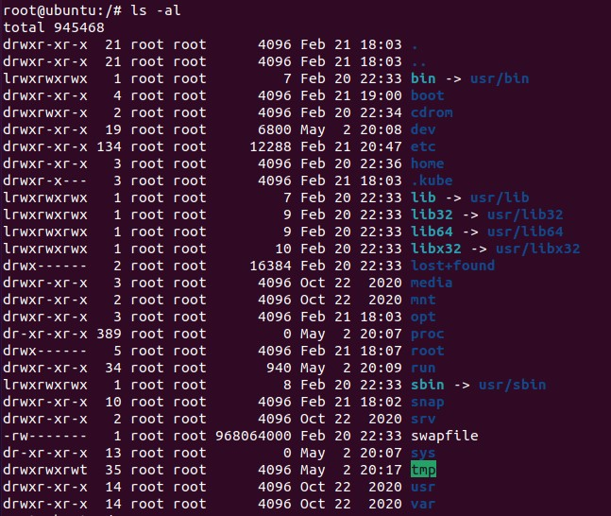
File System Hierarchy
Key locations:
/etc
Configuration files for most applications
/var
Variable files – logs, print spooler etc.
/proc
Information on running processes – effectively a memory dump!

Slide 103
Linux Log Analysis

Slide 104
DFIR Fundamentals – Topics
Incident Response
IR Log Strategy
Common Logs & Locations
System Logs
Authentication & Authorization
Privilege Use
Binary Logs
Audit Logs
Application Logs
Quick Wins
Linux File Systems
Linux Log Analysis
IR Triage

Slide 105
Incident Response Log Strategy
Log Strategy
Logs = Lots of data = Lots of time
Have a plan for your log analysis
Decide on:
What logs do you want to start with
What attacker behavior is likely to look like
How long you will spend on each log
This doesn’t mean ignoring logs!
Application
Authentication
Audit
Others

Slide 106
Common Logs and Locations
Linux keeps lots of logs
Most system logs are in /var/log
Application specific logs may also exist
Application specific log may also exist
Log analysis is essential for effective triage and IR
Primary log sources
Global system log
Authentication logs
Audit logs
Application

Slide 107

Determine the Time Zone
Most logs in Linux are stored in local time
For most Linux distros, the symlink at
/etc/localtime points to the time zone
For Debian distros, the contents of
/etc/timezone also provides the time zone

Slide 108
Common Logs and Locations

Slide 109
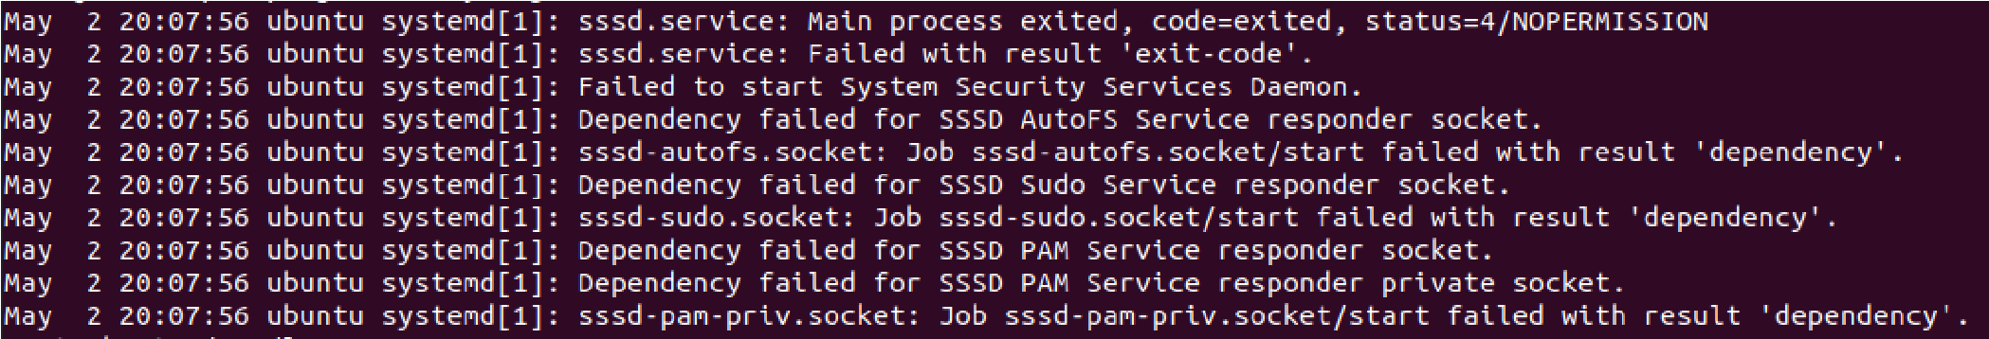
Global System Log (1)
/var/log/messages – CentOS/RHEL
/var/log/syslog - Ubuntu
This file contains the messages logged during system startup, including data from cron, auth, mail etc.
Often huge, very verbose

Slide 110

Global System Log (2)
Often, “grep” is the best tool to carve out important events.
For example, grepping for “root” to find privileged events.
Common IR search strings include
root
CMD
Usb
CentOS only – search for su use:

Slide 111
Authentication and Authorization Logs
Most distros capture account – use data by default
Data includes
Timestamp
Username
Login source
Authentication mechanism
Authentication logs can be plain text, but most are binary.
utmp I wtmp I btmp are binary
auth.log and secure are plain text

Slide 112
Authorization and Privilege Use
/var/log/secure – CentOS/RHEL
/var/log/auth.log – Ubuntu
Contains data on user login and privilege use
Example – using sudo to install a package (Ubuntu)
Example – root adding new user account (CentOS)

Slide 113
Binary Login Logs
Three main files
/var/run/utmp
Users/sessions currently logged in. Data is written to wtmp on system shutdown/reboot.
/var/log/wtmp
Historical utmp data
/var/log/btmp
Failed login events
All are binary files

Slide 114

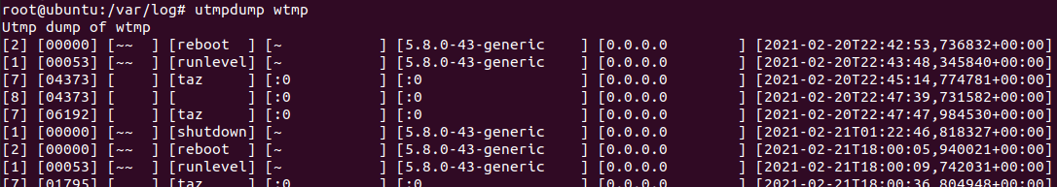
Viewing Binary Login Files
Using last
Using utmpdump

Slide 115
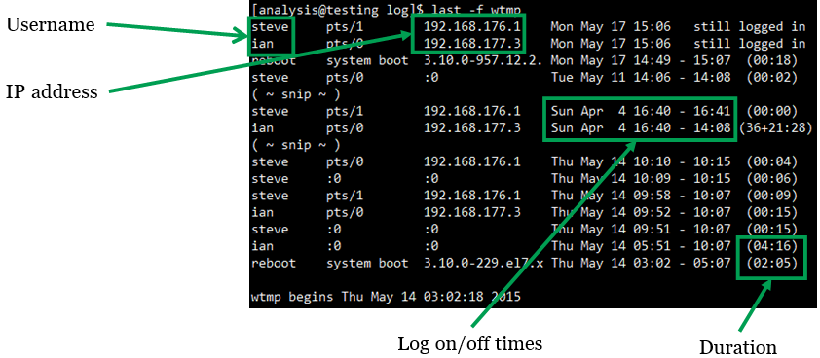
Logins: wtmp Analysis

Slide 116
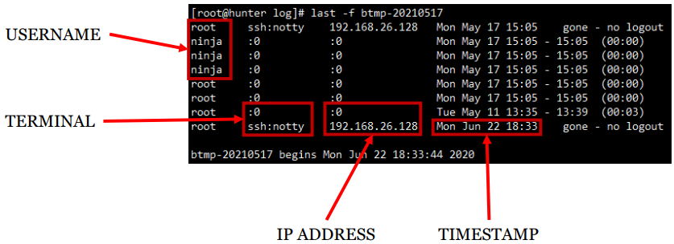
Logins: btmp Analysis

Slide 117
Modern Attack Technique Against Linux

Slide 118
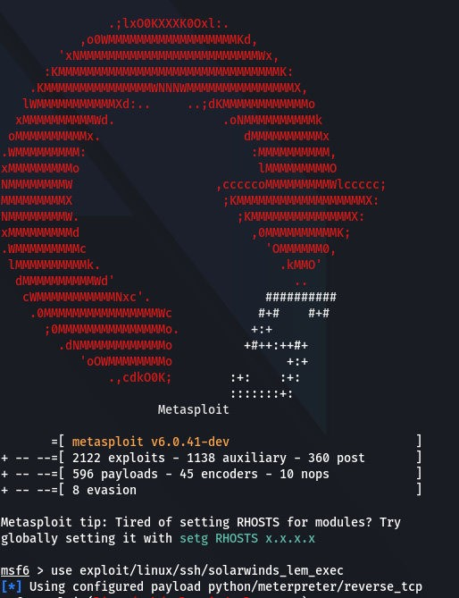
Attacking Linux
Security myths
Open Source != Security
Application weaknesses
Programming Languages
Python
PHP
Ruby/Rails
Lots of attacker tools provided by distro
Python
Netcat

Slide 119
Attacking Linux: Initial Exploitation
Still very much service-side attacks
Attackers look for vulnerable applications
Web server exploits are common
Configuration issues abound
WordPress
Joomla
Django
Open ports/servoces
Accounts

Slide 120

Attacking Linux: Privilege Escalation
Often, very easy
Applications privileges
SUDO everywhere
Plaintext passwords
Shell history
Configuration issues
Wheel/Sudo groups
SUID bit
Path hijacks

Slide 121
Attacking Linux: Persistence
Start up files
.bashrc
Init
SSH keys
Cron tasks
User tasks
Root tasks
File System
Path Modification
Binary replacement

Slide 122
Attacking Linux: Lateral Movement
Can be harder than Windows, but not always
Credentials matter: Passwords or SSH keys/tokens
Linux to Linux
SSH/Socat
Linux to Windows
SSH
RDP
SAMBA/RPCClient/WinRM

Slide 123
Attacking Linux: C2 and Exfiltration
Lots of C2 options
ICMP
DNSCat
Netcat
Exfiltration
Tar frequently used to zip up files
SSH/SFTP/Socat/Port Forwarding
FTP/TFTP outbound
Netcat
Anti-Forensics
touch
rm
Unset HISTFILE/history -e

Slide 124
Linux Log Analysis

Slide 125
Log Analysis and Hunting
Hunting from Log Strategy
Common Logs & Locations
System Logs
Authentication & Authorization
Privilege Use
Binary Logs
Audit Logs
Application Logs
Quick Wins

Slide 126
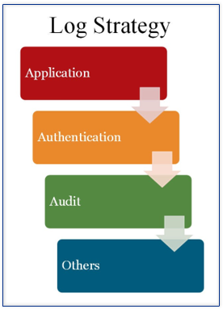
Hunting From Log Strategy
Logs = Lots of data = Lots of time
Have a plan for your log analysis
Decide on:
What logs do you want to start with
What attacker behavior is likely to look like
How long you will spend on each log
This doesn’t mean ignoring logs!

Slide 127
Common Logs and Locations
Linux keeps lots of logs
Most system logs are in /var/log
There are exceptions… (/var/run…)
Application specific logs may also exist
Log Analysis is essential for effective triage and IR
Primary log sources
Global system log
Authentication logs
Audit logs
Applications

Slide 128
Common Logs and Locations

Slide 129
Global System Log (1)
/var/log/messages – CentOS/RHEL
/var/log/syslog - Ubuntu
This file contains the messages logged during system startup, including data from cron, auth, mail etc.
Often huge, very verbose

Slide 130
Global System Log (2)
Often, “grep” is the best tool to carve out important events.
For example, grepping for “root” to find privileged events.
Common IR search strings include
root
CMD
Usb
CentOS only – search for su use:

Slide 131
Authentication and Authorization Logs
Most distros capture account-use data by default
Data includes
Timestamps
Username
Login source
Authentication mechanism
Authentication logs can be plain text, but most are binary.
utmp | wtmp | btmp are binary
auth.log and secure are plain text

Slide 132
Authorization and Privilege Use
/var/log/secure – CentOS/RHEL
/var/log/auth.log – Ubuntu
Contains data on user login and privilege use
Example – using sudo to install a package (Ubuntu)
Example – root adding new user account (CentOS)

Slide 133
Binary Login Logs
Three main files
/var/ run/utmp
Users/sessions currently logged in. Data is written to wtmp on system shutdown/reboot.
/var/log/wtmp
Historical utmp data
/var/log/btmp
Failed login events.
All are binary files

Slide 134
Viewing Binary Login Files
Using last
Using utmpdump

Slide 135
Logins: wtmp Analysis

Slide 136
Logins: btmp Analysis

Slide 137
Finally: lastlog/faillog
/var/log/lastlog
Displays the last login time for users on the system.
Use lastlog command to view
Unreliable with terminal logins
/var/log/failog
Records failed authorization events
Very unreliable
Better to use secure /auth.log
Removed from CentOS

Slide 138
Audit Logs
Driven by auditd
/var/log/audit/audit.log
Text format: can be read with any tools but format is challenging
grep /usr/bin/su audit.log
type=USER_AUTH msg=audit(1620581024.735:176): pid=6778 uid=1000 auid=1000 ses=3 subj=unconfined_u:unconfined_r:unconfined_t:s0-s0:c0.c1023 msg='op=PAM:authentication grantors=pam_unix acct="root" exe="/usr/bin/su" hostname=localhost.localdomain addr=? terminal=pts/1 res=success'UID="userone" AUID="userone"
ausearch command allows user-friendly searching
• ausearch -m USER_AUTH
type=USER_AUTH msg=audit(1620581024.735:176): pid=6778 uid=1000 auid=1000 ses=3 subj=unconfined_u:unconfined_r:unconfined_t:s0-s0:c0.c1023 msg='op=PAM:authentication grantors=pam_unix acct="root" exe="/usr/bin/su" hostname=localhost.localdomain addr=? terminal=pts/1 res=success'

Slide 139
Application Logs
Web server: Apache logs, very useful
/var/log/nginx
/var/log/apache2
/var/log/httpd
Mail Server
/var/log/mail
Databases
/var/log/mysqld.log
/var/log/mysql.log
/var/log/mariadb/*
Remember: The applications running on a system and where they log can vary. Make sure you validate this.

Slide 140
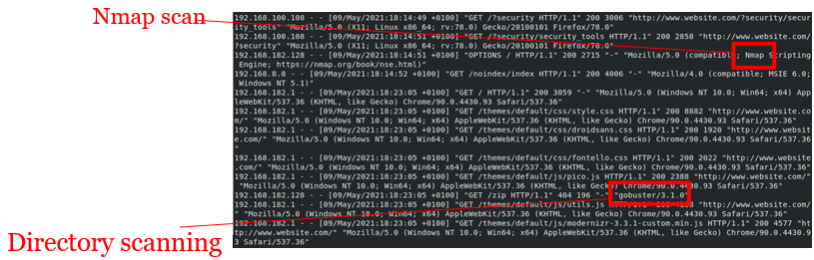
Application Logs: HTTPd
Can be an hunting goldmine
Found on
Web servers
Proxy servers
Databases servers
General point: If a web server is running, it is likely to have been attacked

Slide 141
Web Server Logs
Access log (access_log)
Captures HTTP requests to the web server
Includes HTTP Method (GET, POST, HEAD, etc.)
Includes HTTP Response code (200, 404, etc.)
Error log (error_log)
Any errors generated by the server
Diagnostic information
SSL logs may also exist
ssl_access_log and ssl_request_log can be useful

Slide 142
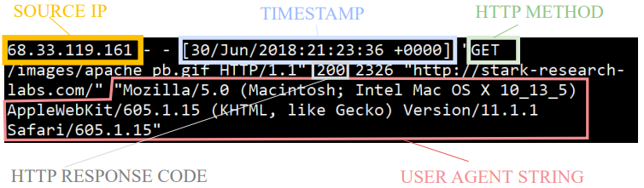
access_log
Example: Apache Combined Log Format

Slide 143
Quick Wins
Review HTTP methods used
Scanning tools often try obscure methods like OPTIONS, DELETE, or PATCH
Webshells and exploits often need a POST request
Look at the pages requested
Look for random names or non-existent files
Attackers often leave default names on shells (c99.php, etc.)
Start with files that return HTTP 200 responses
Analyze user agent strings
Although they can be set by the attacker, they can also allow you to trace and identify an attacker
Especially valuable for internal web servers

Slide 144
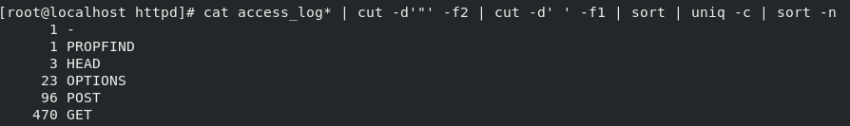
Quick Wins: Example 1
Checking the methods
Dig in to the use of OPTIONS (exclude localhost noise)
Now there is a single IP exhibiting suspicious behavior which can be investigated further

Slide 145
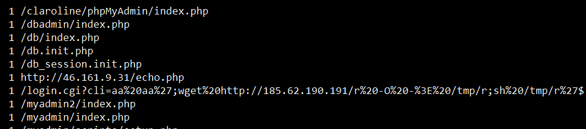
Quick Wins: Example 2
Checking the pages requested
cat access log* | cut -d '"' -f2 | cut -
d' ' -f2 | sort \ uniq -c \ sort -n
Identifies suspicious files for further review

Slide 146
LAB HANDS ON SESSION

